Slide 1
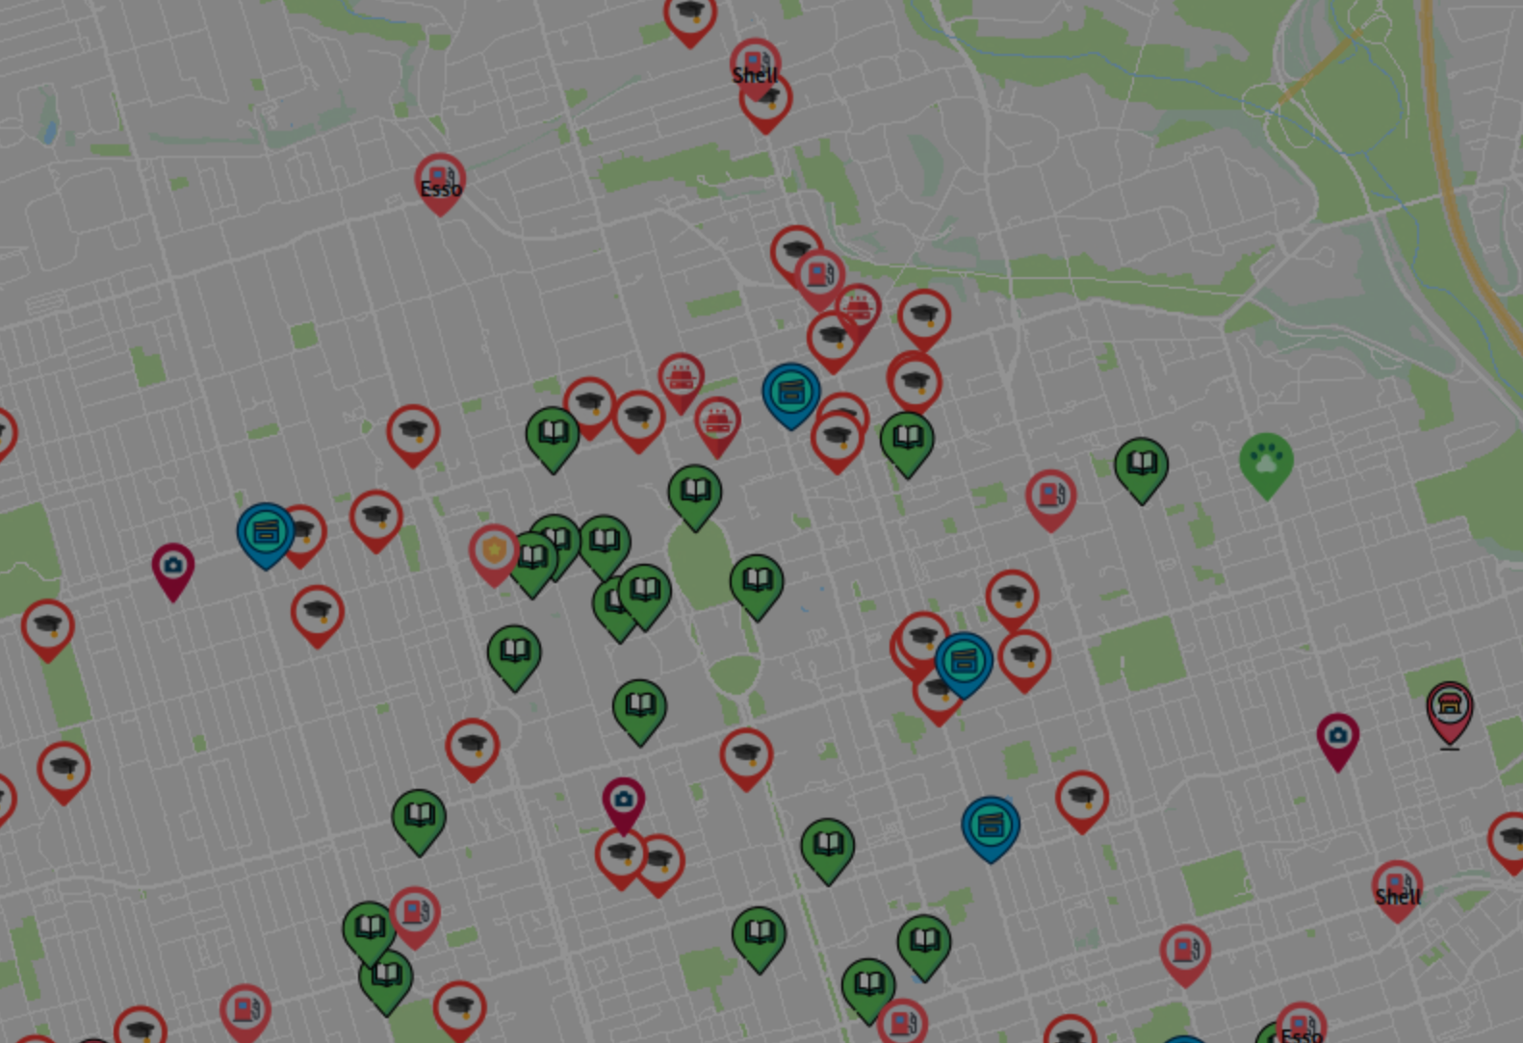

ECE297 Team 002
EasyTourist Maps is Proudly Designed by
Hamza Mohammed
Mario Figallo
Sky Ning

Slide 2
OVERVIEW
01
Core Message & Target User
02
Pathfinding Algorithms Achievements
03
Usability Enhancing Features
04
Future Pitch
Conclusion
05

Slide 3
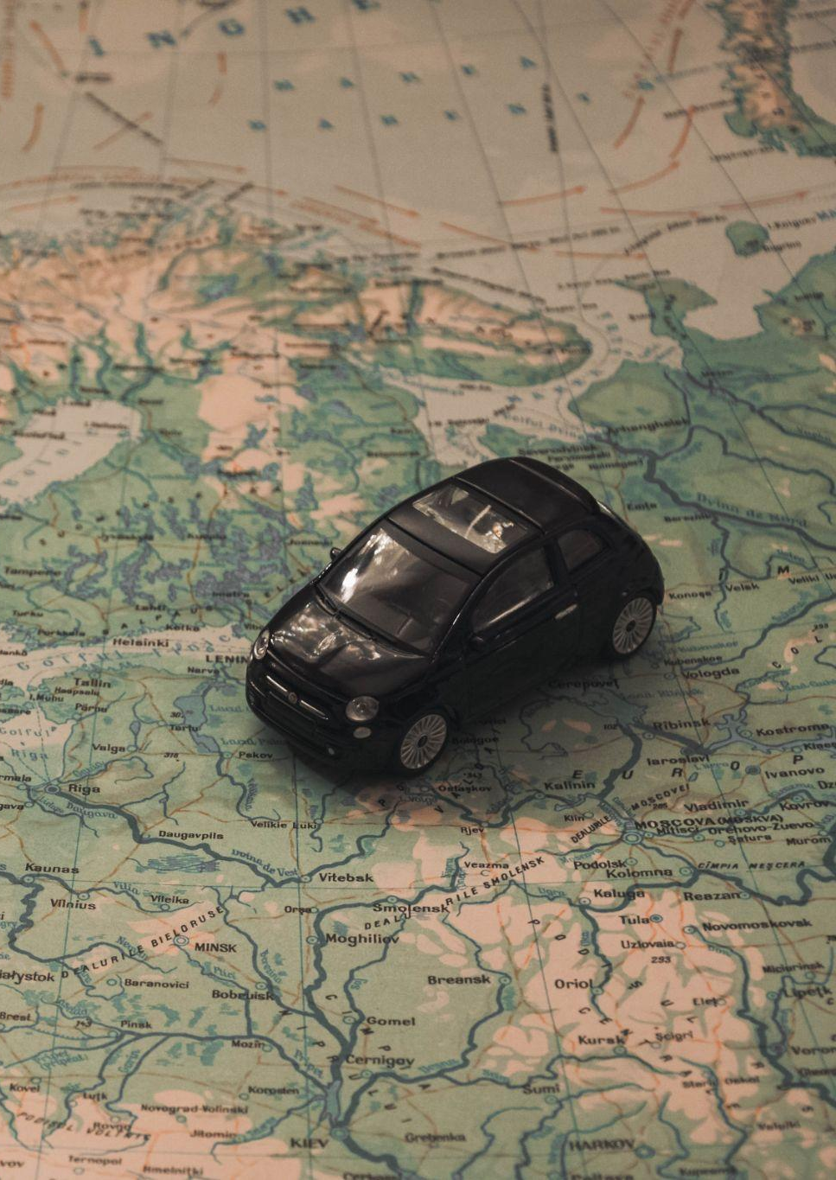
Our core message
A map made for all kinds of tourists
We utilized the Nielsen’s usability concepts of efficiency, learnability, and error rate to optimize the map functionality for elderly tourists [1].

Slide 4
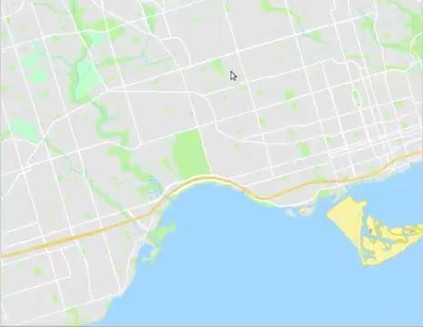
Responsiveness in our map enhances efficiency of use
21 FPS without features (46 ms)
Almost like a movie! [2]
4 FPS worst case (260 ms)
10 FPS on most common uses (105ms)
Video 1. Demonstration of GIS Performance

Slide 5
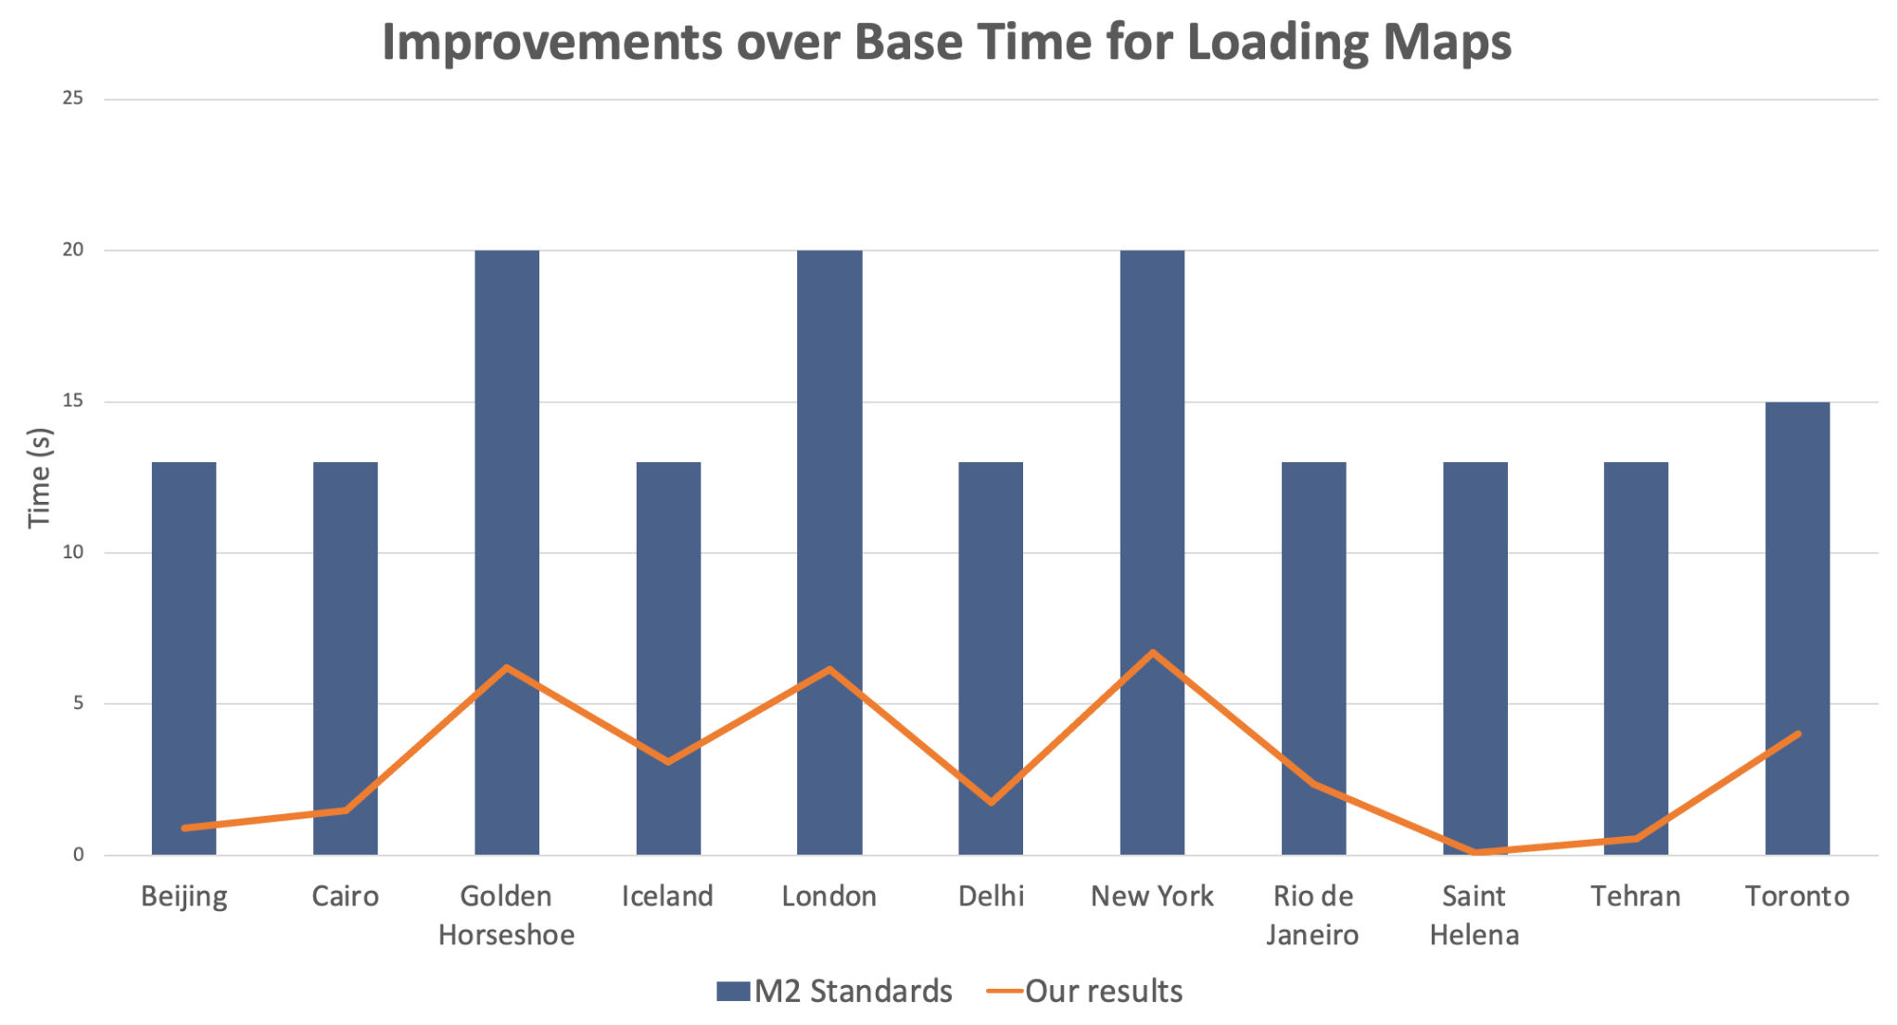
Average of 81% improvement!
NOW
Figure 1. Improvements over Base Time for Loading Maps

Slide 6
OUR ALGORITHMS ARE OPTIMIZED TO BE EFFICIENT FOR TOURISTS
A*
Enables us to find the distance between two points as fast as possible
Our heuristic takes into account:
Segment travel time
Straight line to destination by the maximum possible velocity

Slide 7
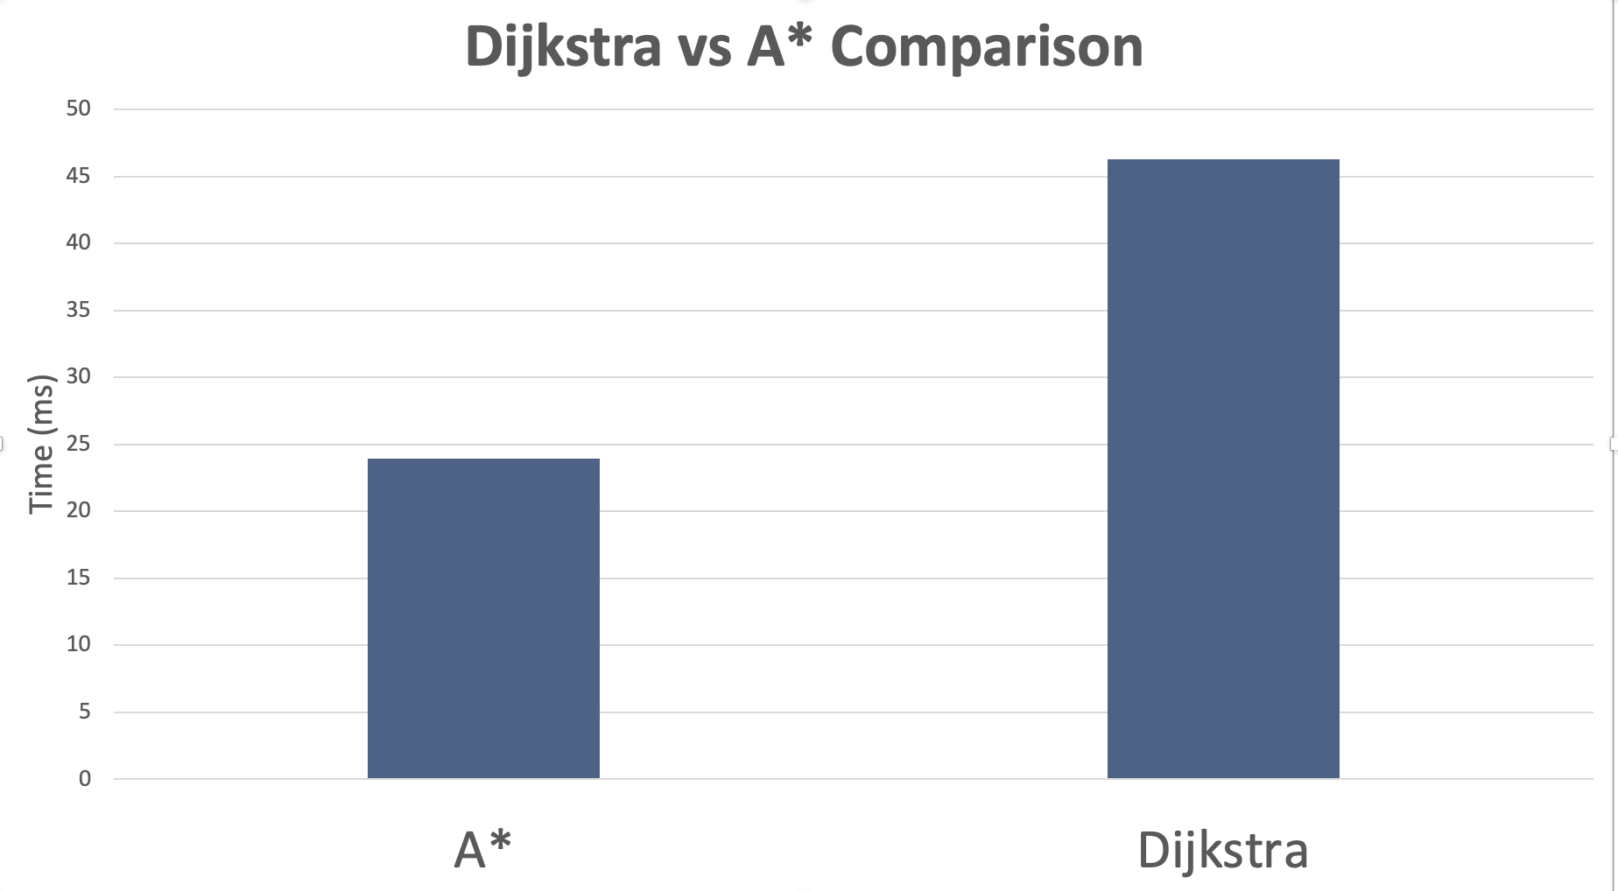
Average of 50% improvement!
NOW
Figure 2. Dijkstra vs A* Comparison

Slide 8
OUR ALGORITHMS ARE OPTIMIZED TO BE EFFICIENT FOR TOURISTS
A*
Greedy Algorithm
Enables us to find the distance between two points as fast as possible
Enables us to find the best possible path to take when having multiple destinations
Our heuristic takes into account:
Segment travel time
Straight line to destination by the maximum possible velocity

Slide 9
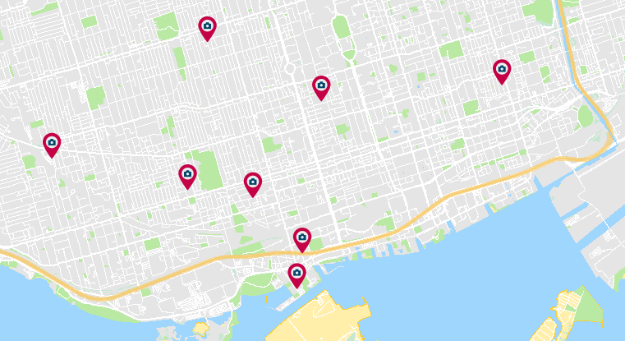
NOW
Mercury is the closest planet to the Sun and the
Figure 3. Demonstration of Greedy Algorithm

Slide 10
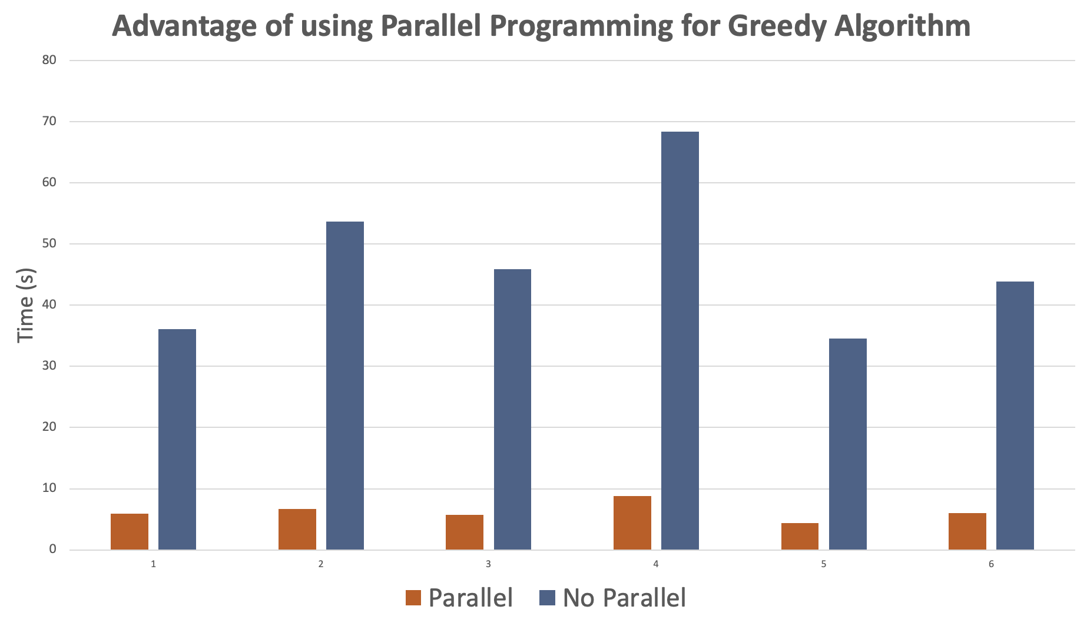
Average of 86% improvement!
NOW
Figure 4. Advantage of Using Parallel Programming for Greedy Algorithm

Slide 11
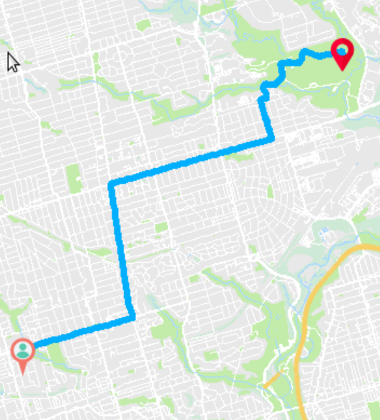
Our Highly Intuitive Pathfinding UI
Bold Icons
Bright Colours
Simple One button UI
Figure 5. Screenshot from our GIS

Slide 12


Slide 13
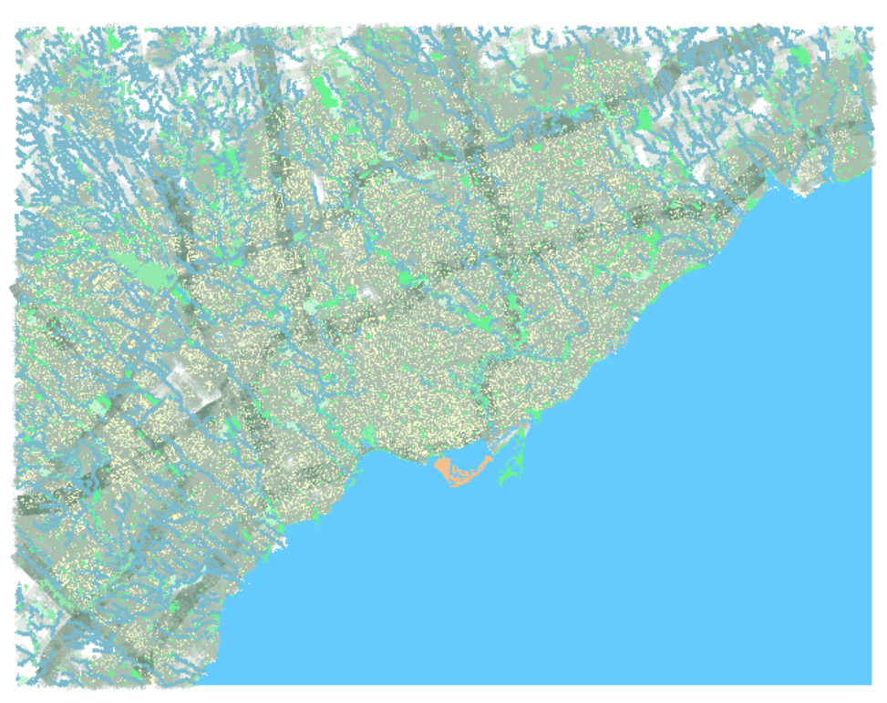
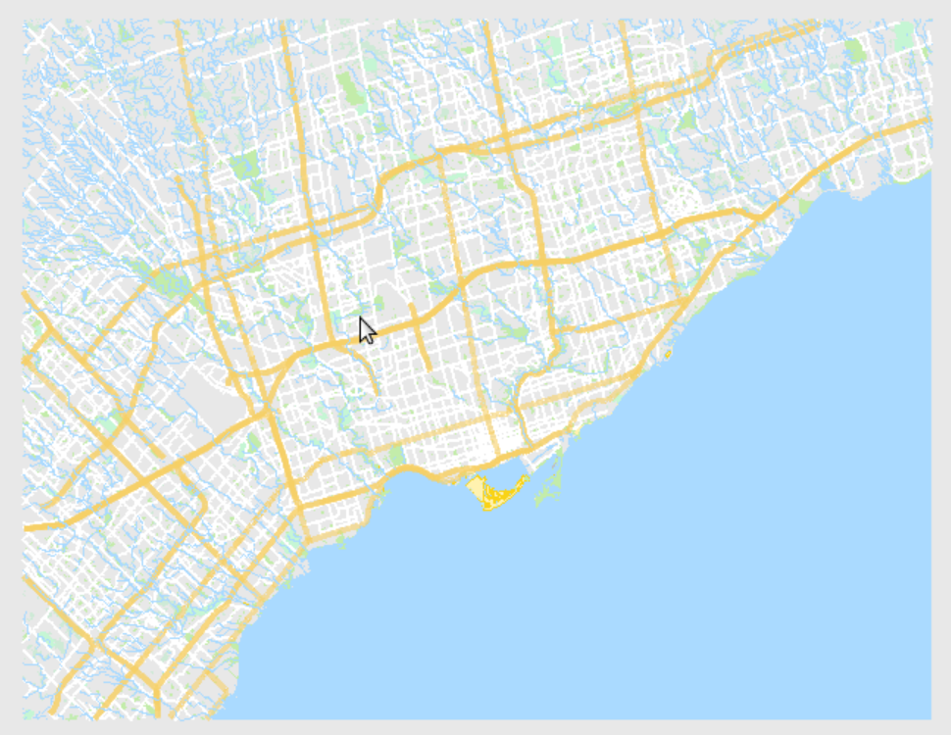
Multi Layered Progressive Disclosure
and its effect on efficiency and Responsiveness
Figure 6. Screenshot from first implementation of our GIS
Figure 7. Screenshot from our GIS
Notes:
Talk about how it also increases responsiveness and efficiency (as we hide useless information such as small buildings and small streets) and talk about the code

Slide 14
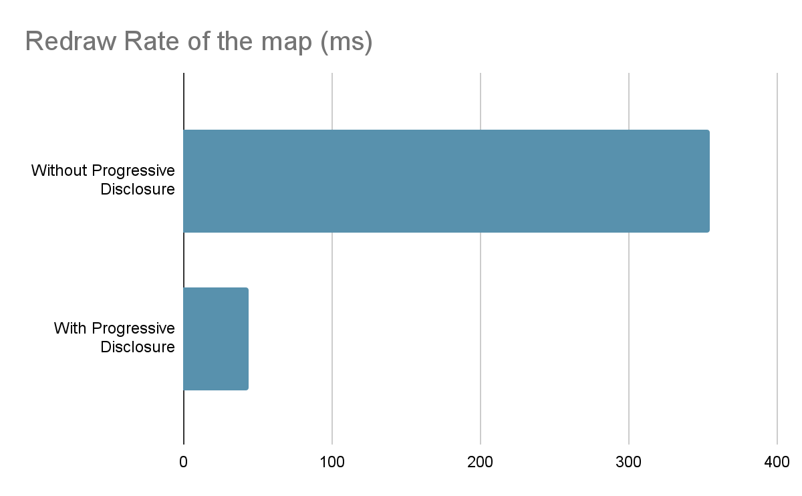
Average 10 fold improvement!
Multi Layered Progressive Disclosure and its effect on efficiency and Responsiveness
Time (ms)
Figure 8. Responsiveness Improvements using progressive disclosure
Notes:
Talk about how it also increases responsiveness and efficiency (as we hide useless information such as small buildings and small streets)

Slide 16
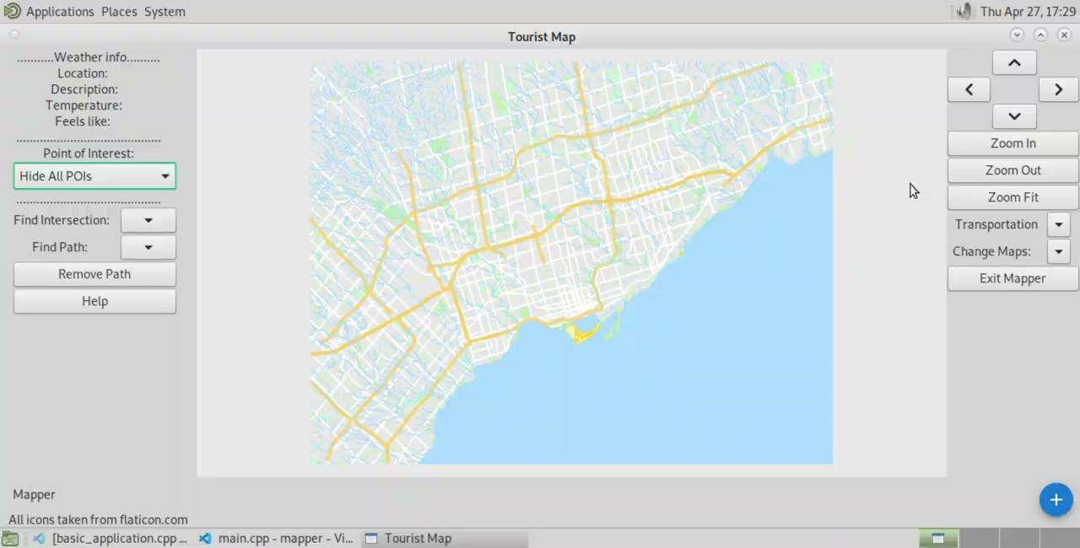
Additional useful features for Tourists
Autocomplete
Public Transit
Live Weather

Slide 17








Carefully Chosen Icons for POIs (Examples)
Gas Station
Fast Food
Library
Attraction
Cinema
Hospital
Police
Marketplace
Figure 9. A selection of icons used in EasyTourist Maps

Slide 18
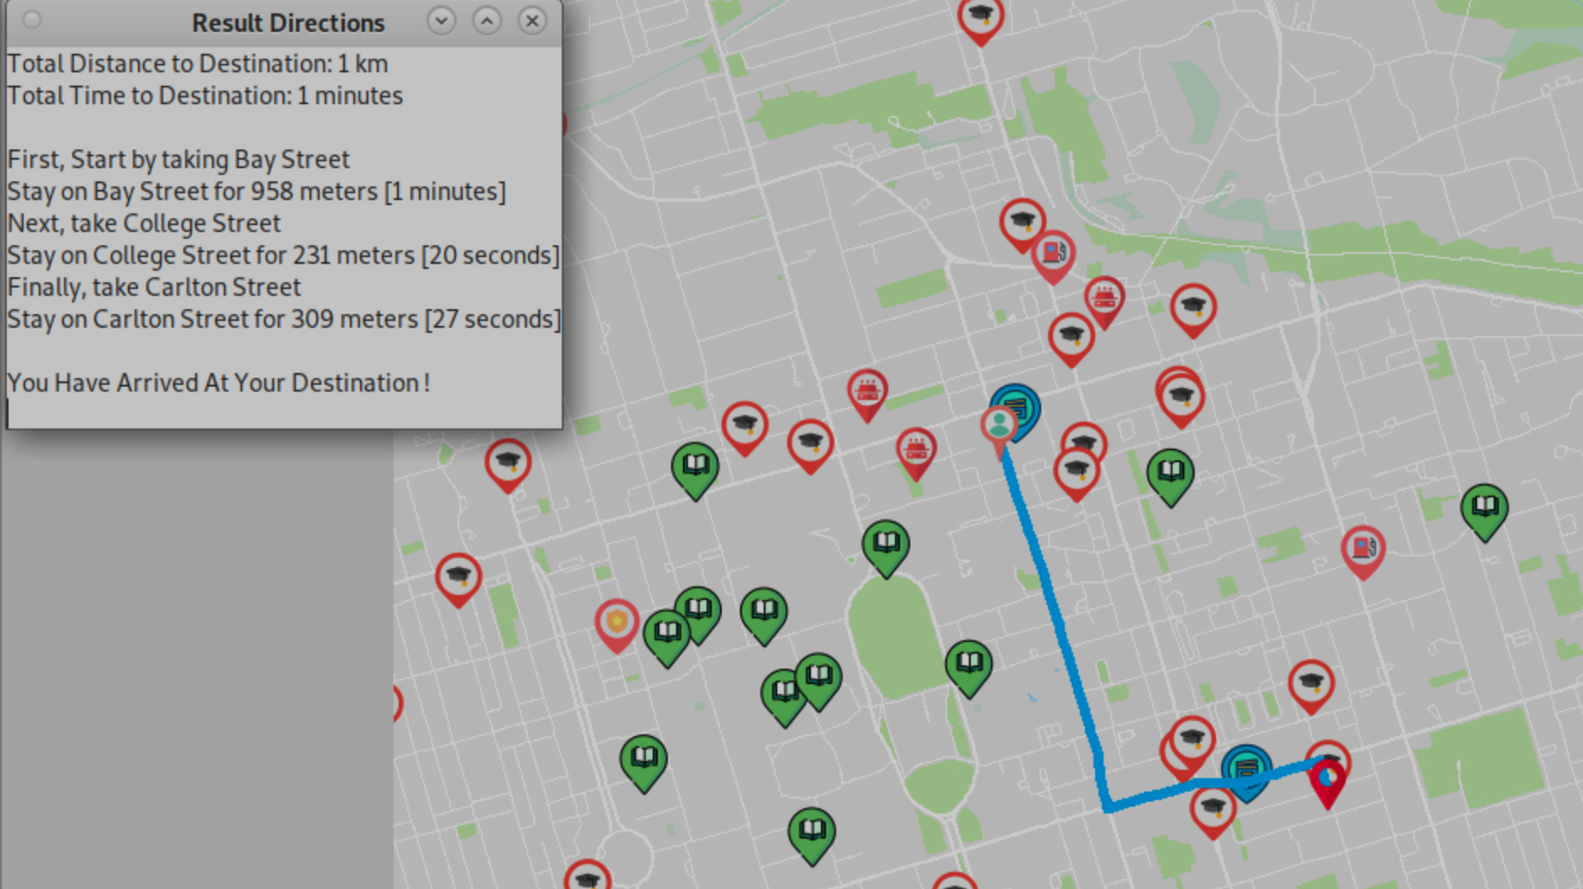
POIs combined with right-click pathfinding for easy navigation

Slide 19
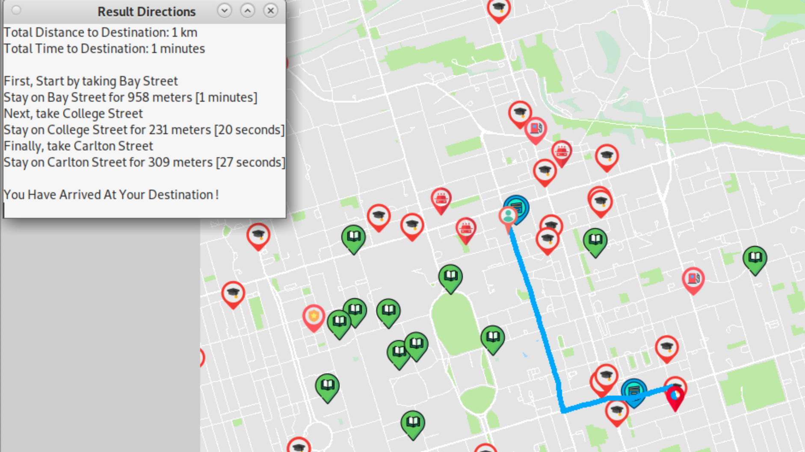

Figure 10. Screenshot from out GIS showing directions

Slide 20
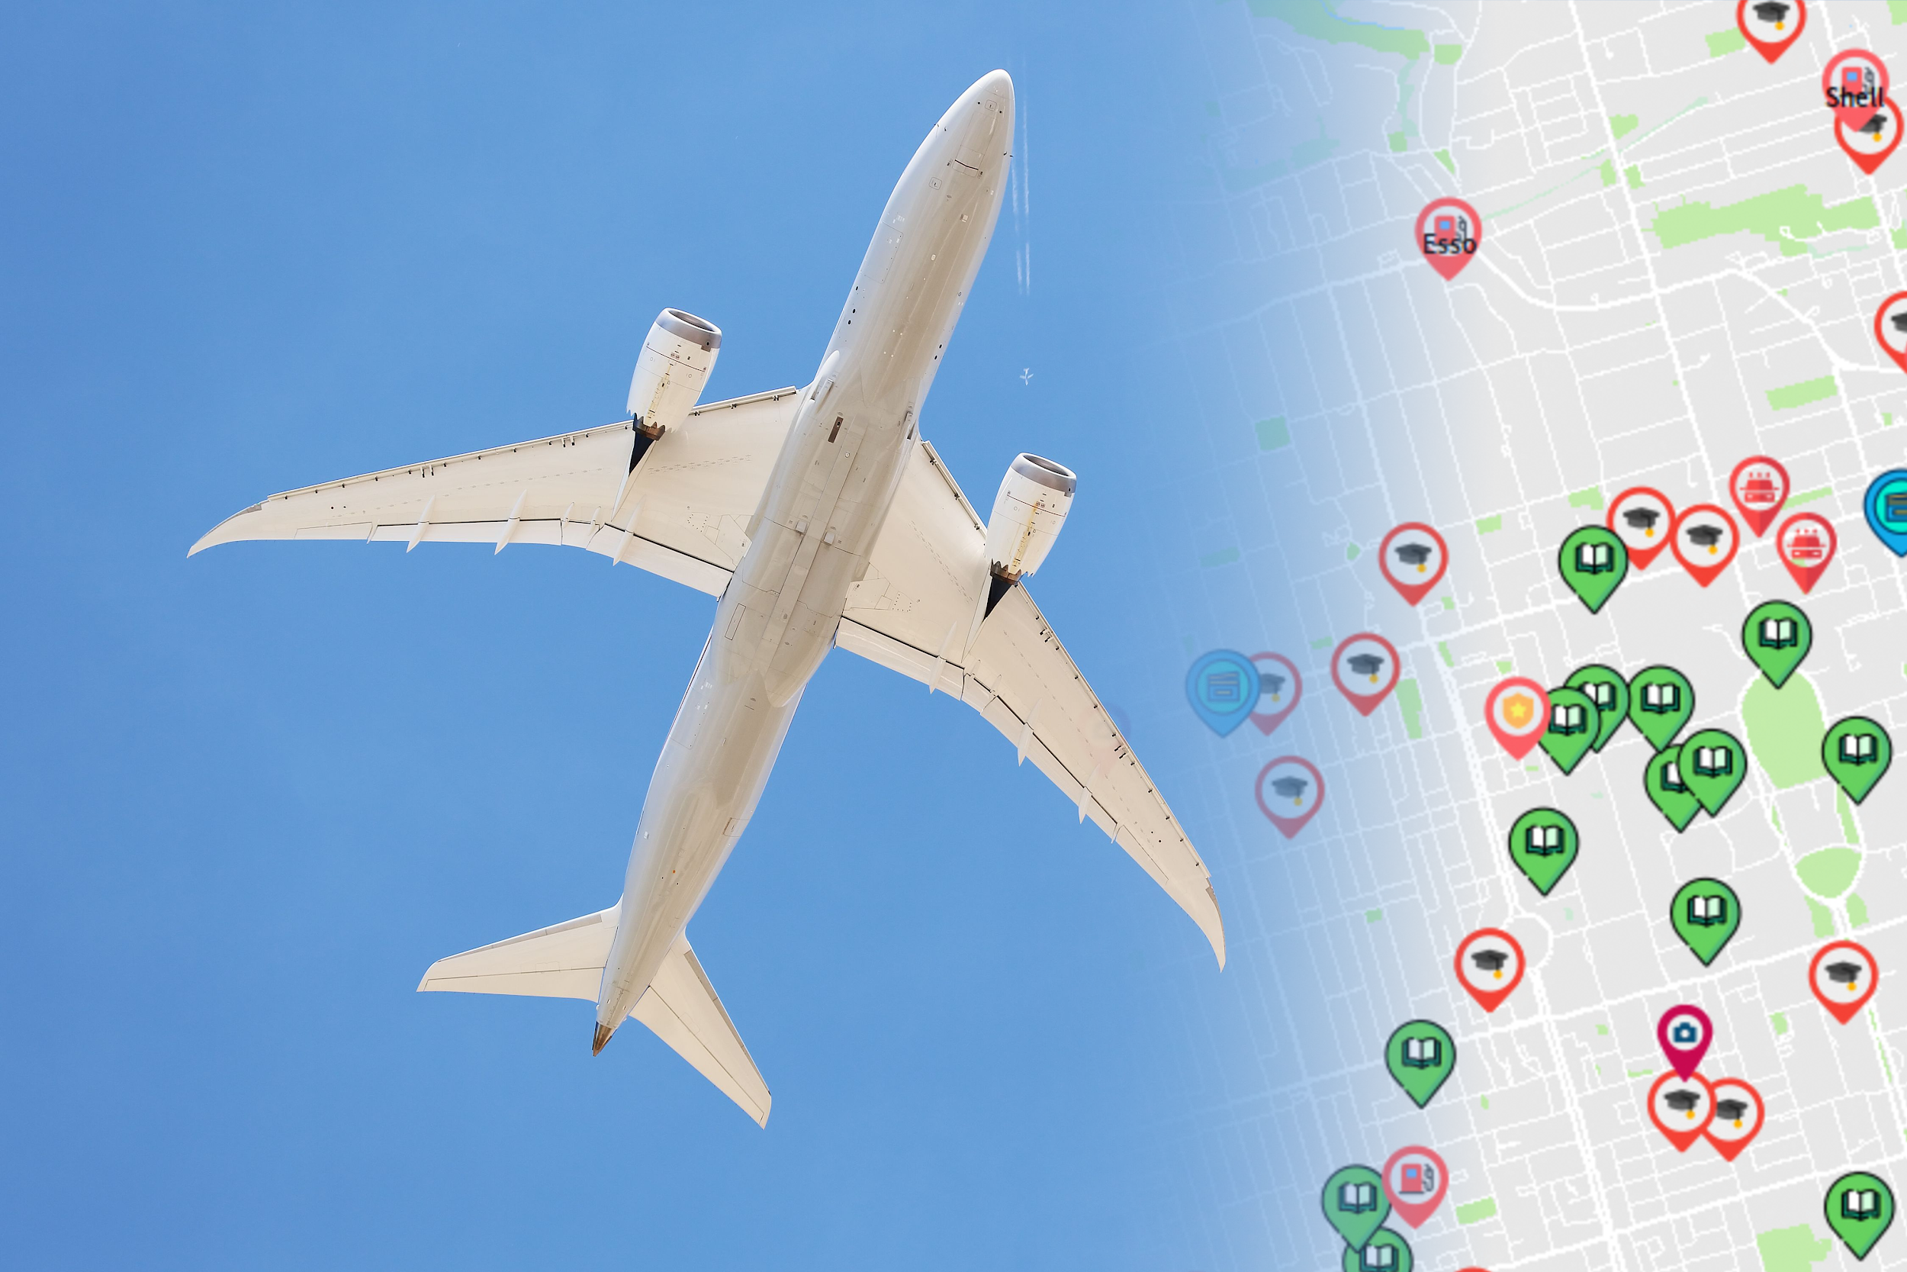
Future Pitch

Slide 21
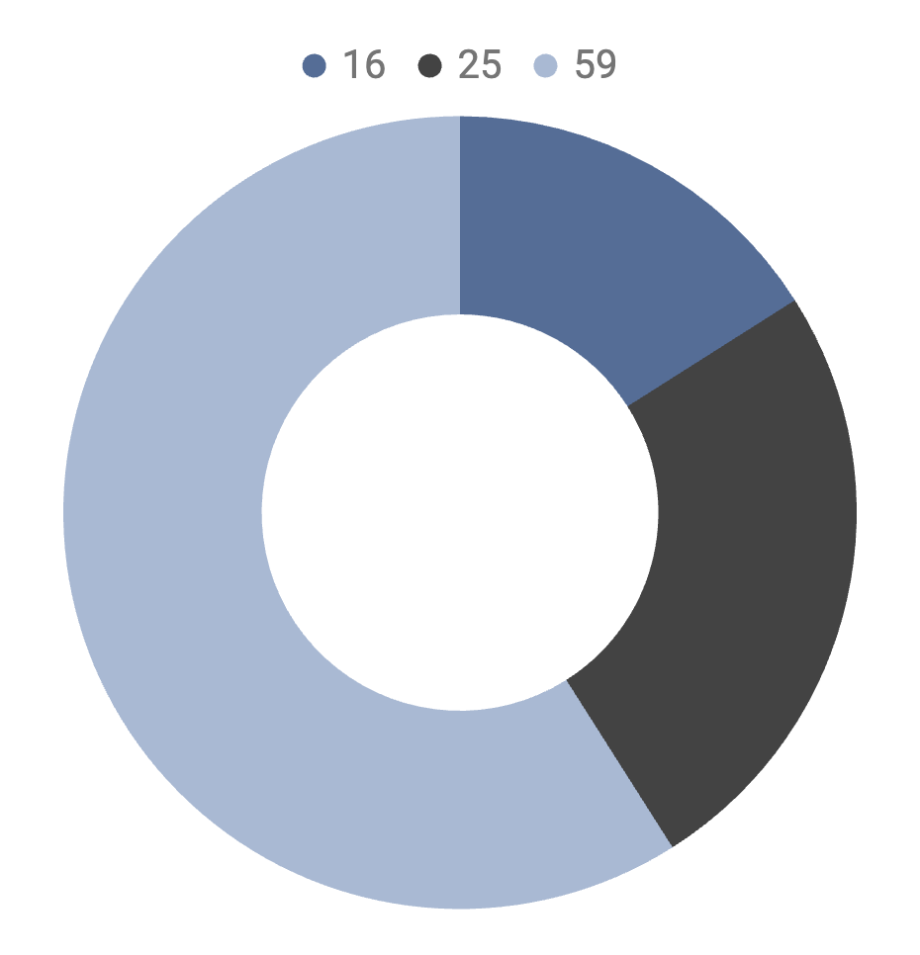
41% of Tourists are over 55 years old
Younger Age Group
59%
Age 55-65
16%
Age 65+
25%
Figure 11. According to Statistical Agency Eurostats, in 2019, 41% of the European tourists are aged 55+ [3]

Slide 22
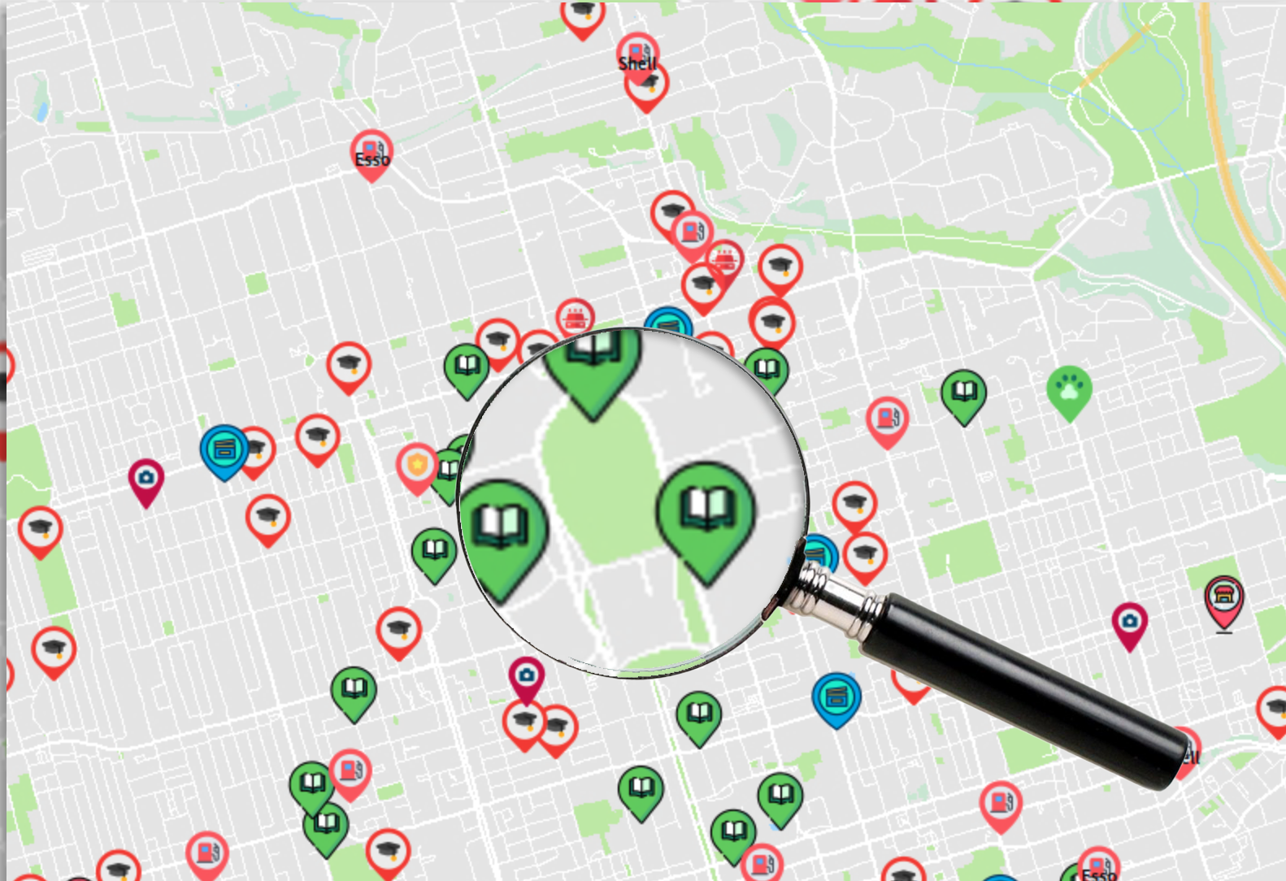
WHAT WE WILL WORK ON
Elderly Mode
Auto Correct [4]
Large Fonts
Screen Magnifier & Reader
Returns closest matches

Slide 23
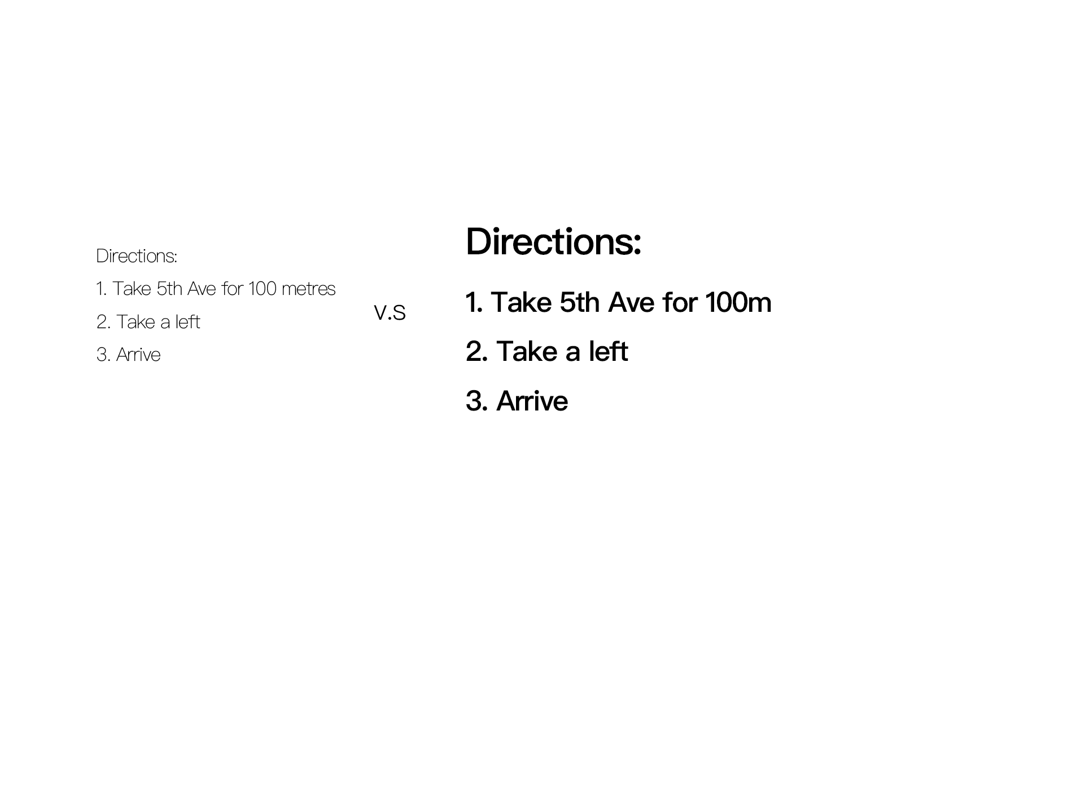

ELDERLY MODE
Large & Bold Fonts
Built-in Magnifier and Screen Reader
Older people with reduced vision often have hard time reading small texts [5].
Figure 11. Small v.s. Large Fonts
Figure 12. Proposed magnifier for our GIS

Slide 24
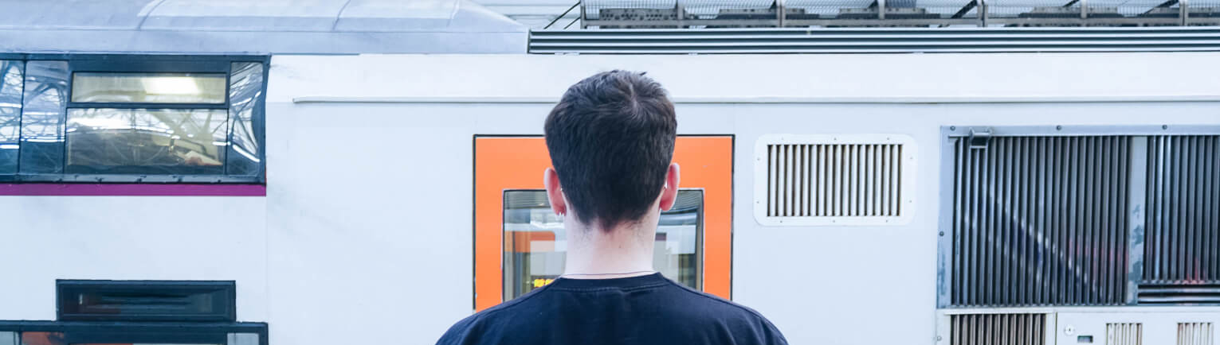
Proposed Implementation
Large Fonts
Magnifier
Text-to-Speech
Font size in code.
GdkPixbuf library
Incorporate free text-to-speech APIs such as the AWS text-to-speech API.

Slide 25
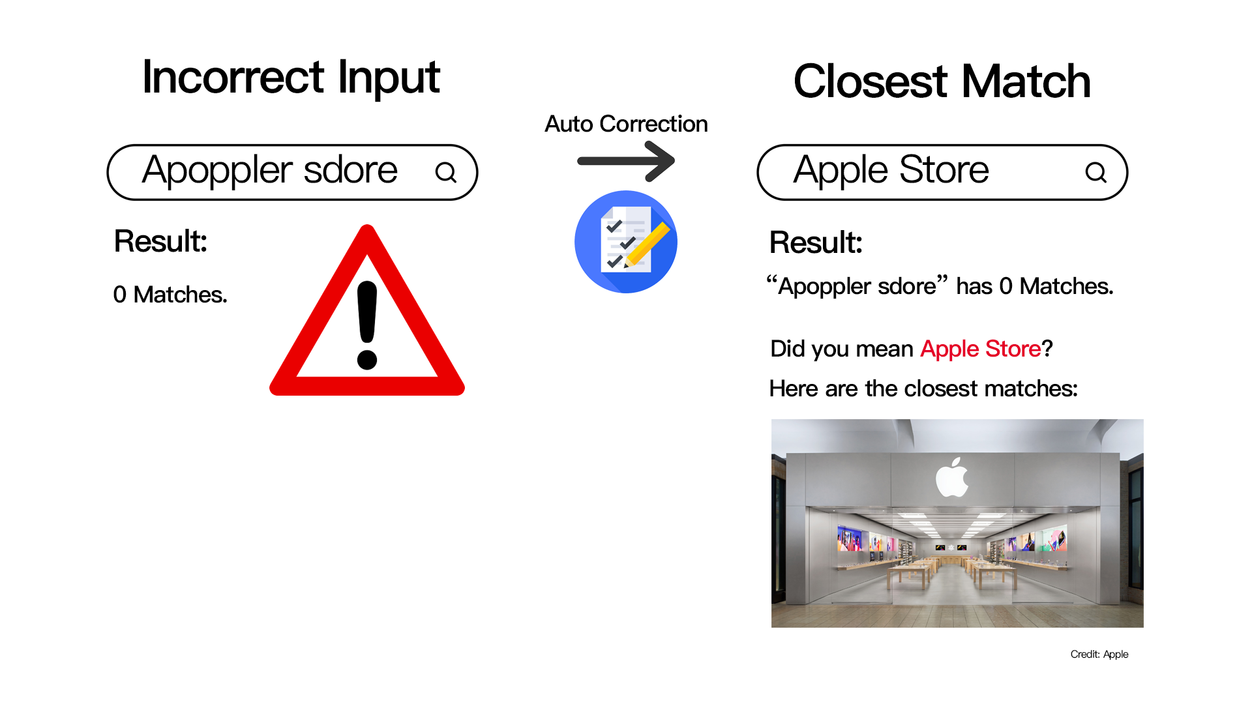
AUTO CORRECT
This can be implemented using Regex.

Slide 26
Recap and Conclusion
01
CORE MESSAGE &
TARGET USER
02
PATHFINDING ALGORITHM
ACHIEVEMENTS
03
USABILITY ENHANCING FEATURES
04
FUTURE PITCH
Easy and Efficient Tourist-oriented map
A* algorithm + Parallel Greedy algorithm is fast!
Intuitive UI, Convenient pathfinding.
Elderly Mode, Auto Correction

Slide 27
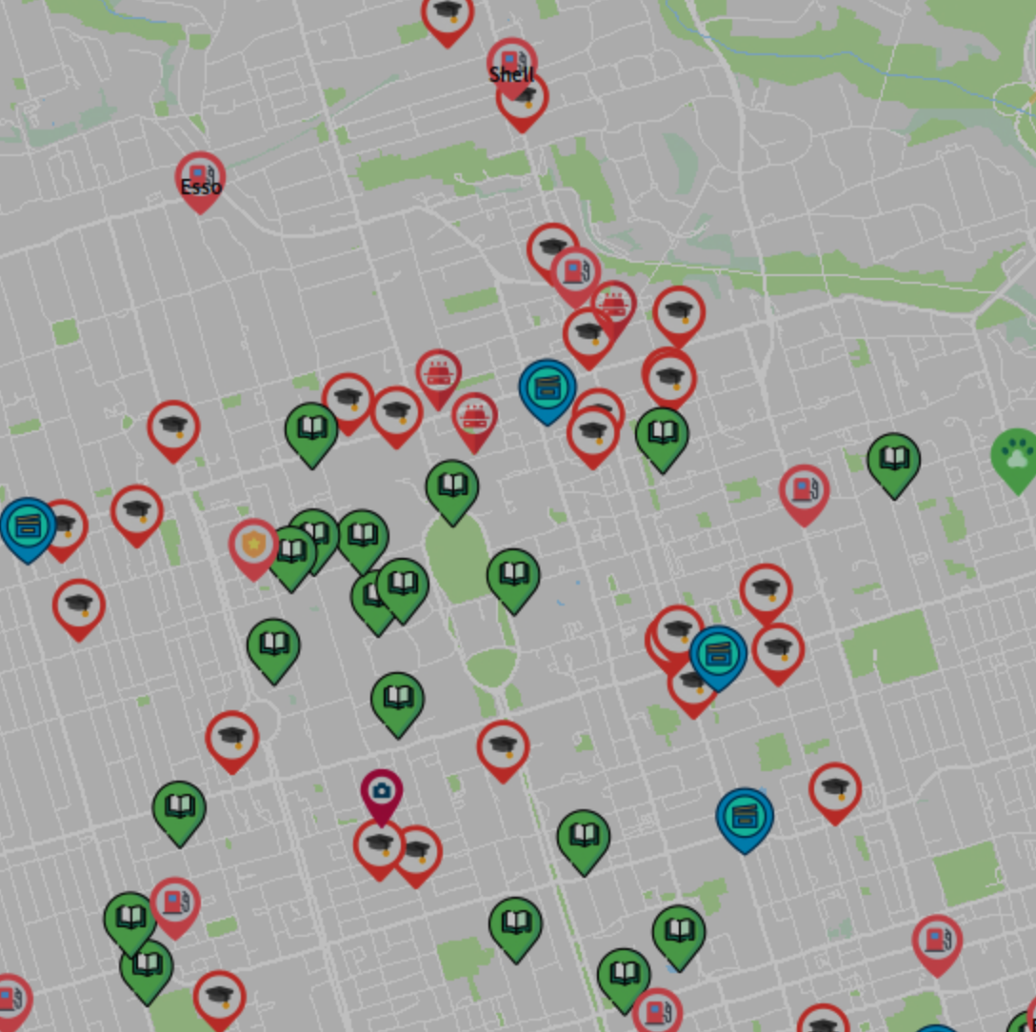
Takeaway
With EastTourist Maps, we intended to create an elderly tourist-oriented map application that is easy to use, easy to learn and highly efficient.

Slide 28
References
We thank Slidesgo, Flaticon and Freepik for the template of this presentation
[1] J. Nielsen, “Usability 101: Introduction to Usability,” Nielsen Norman Group, January 3, 2012. [Online]. Available: https://www.nngroup.com/articles/usability-101-introduction-to-usability/
[2] Adobe. Frame Rate for Video: How to Choose the Right One, 2023, April 28. [Online]. Available: https://www.adobe.com/ca/creativecloud/video/discover/frame-rate.html#:~:text=Motion%20pictures%2C%20TV%20broadcasts%2C%20streaming,standard%20frame%20rate%20of%2024fps. [Accessed on April 28th, 2023]
[3]Eurostats, “Tourism trends and ageing,” Eurostats, March, 2021. [Online]. Available: https://ec.europa.eu/eurostat/statistics-explained/index.php?title=Tourism_trends_and_ageing#:~:text=Looking%20at%20the%20population%20groups,of%20the%20population%20aged%2015%2B.
[4] D. M. Burke and M. A. Shafto, “Aging and language production,” Current directions in psychological science, 2004. [Online]. Available: https://www.ncbi.nlm.nih.gov/pmc/articles/PMC2293308/. [Accessed: 29-Apr-2023].

Slide 29
References
[5] S. Girdler, T. L. Packer, and D. Boldy, “The impact of age-related vision loss - sage journals.” [Online]. Available: https://journals.sagepub.com/doi/abs/10.3928/15394492-20080601-05. [Accessed: 29-Apr-2023].
[6] Slidesgo. “Engineering Project Proposal,” Slidesgo.com. N.d., [Online]. Available https://slidesgo.com/. [Accessed on April 27th, 2023]

